Slide 1
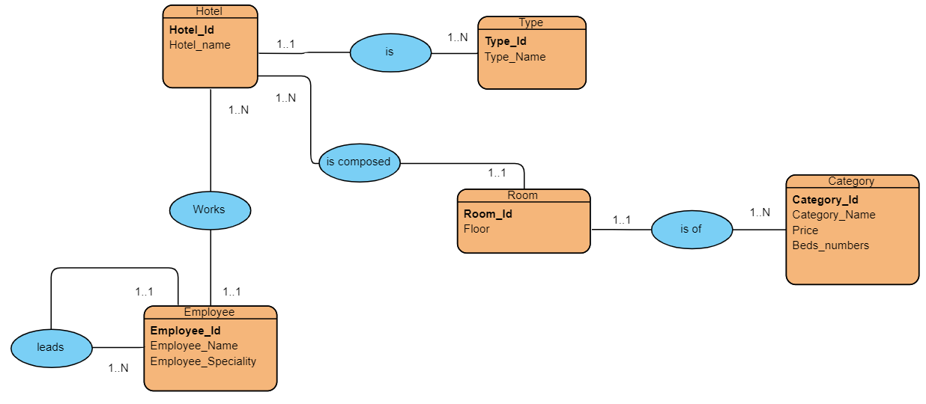
Relational model

Slide 2
Relational model: Hotel:(Hotel id ,Hotel name ,Type id ) Type:(Type id ,Type name) Room:(Room id , Floor ,Category id ) Category:(Category id ,Category name,Price, Beds numbers ) Employee:(Employee id ,Employee name ,Employee speciality)

